Slide 1
Object Oriented Programming
Member Function within the class & outside of class
Lecture#04

Slide 2
Defining member function outside of the class in C++
The functions associated with a class are called member functions of that class.
Member functions must be declared inside the class but they can be defined either inside the class or outside the class.

Slide 3
Different ways of defining member functions of a class
There are two ways in which the member functions can be defined :
Inside the class definition
Outside the class definition

Slide 4
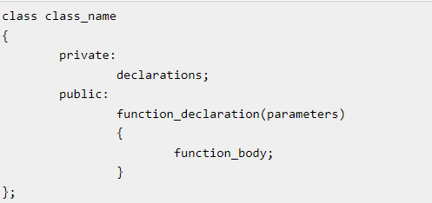
Defining member function inside of the class definition
(member function definition with declaration)
Syntax:

Slide 5
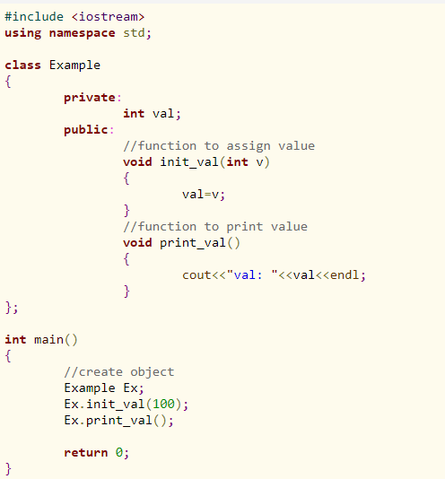

In the above example, public member functions init_val() and print_val() are defined inside the class definition.

Slide 6
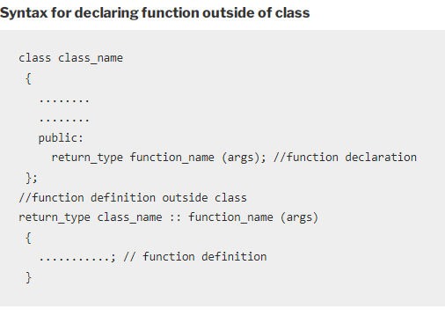
Defining member function outside of the class definition
A public member function can also be defined outside of the class with a special type of operator known as Scope Resolution Operator represents by :: (double colon).
Syntax:

Slide 7
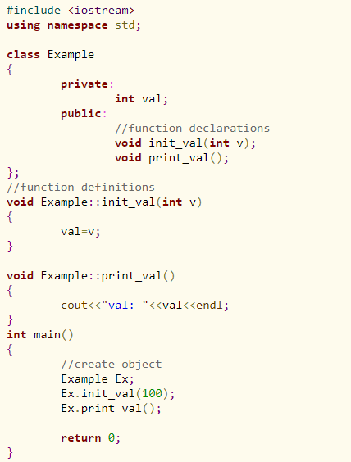


Slide 8
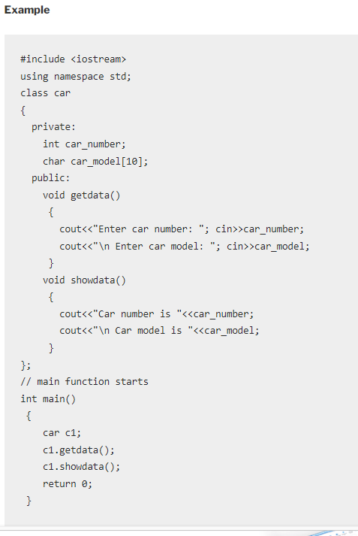
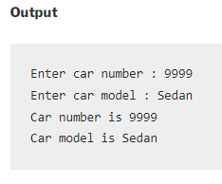
Here getdata() and showdata() are the member function defined inside the class .

Slide 9
Class Activity
Repeat the previous example for defining member function outside of the class.

Slide 10
const
We’ve seen several examples of const used on normal variables to prevent them from being modified.
const can be used with function arguments to keep a function from modifying a variable passed to it by reference.
Now that we know about classes, we can introduce some other uses of const: on member functions, on member function arguments, and on objects.

Slide 11
const member functions
Constant member functions are those functions that are denied permission to change the values of the data members of their class.
A const member function guarantees that it will never modify any of its class’s member data.
To make a member function constant, the keyword const is appended to the function prototype and also to the function definition header.

Slide 12
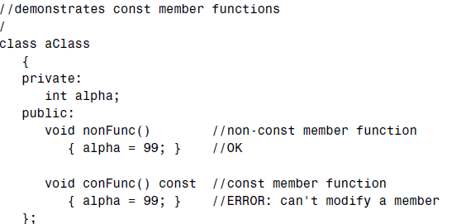
const member functions
The non-const function nonFunc() can modify member data alpha, but the constant function conFunc() can’t. If it tries to, a compiler error results.

Slide 13
const member functions
A function is made into a constant function by placing the keyword const after the declaration but before the function body
If there is a separate function declaration, const must be used in both declaration and definition.
Member functions that do nothing but acquire data from an object are obvious candidates for being made const, because they don’t need to modify any data.

Slide 14
Use of const Member function
Making a function const helps the compiler flag errors, and tells anyone looking at the listing that you intended the function not to modify anything in its object.

Slide 15
const object
we’ve seen that we can apply const to variables of basic types such as int to keep them from being modified.
In a similar way, we can apply const to objects of classes. When an object is declared as const, you can’t modify it.
It follows that you can use only const member functions with it, because they’re the only ones that guarantee not to modify it.
We will discuss it later discussion of constructor.

Slide 16
Object as a function Argument
Object can be passed as a function argument and can be return from function.
See next slide

Slide 17
